Slide 1
Earth Engine, Python and IPython/Jupyter Notebooks
Earth Engine User Summit 2016
Tyler Erickson Senior Developer Advocate, Earth Engine

Slide 2
Session Goals
Learn
the similarities and differences between the Javascript and Python APIs.
how to build an environment for running the Python API
about Jupyter notebooks
Feedback
What should the Earth Engine team to improve the experience?

Slide 3

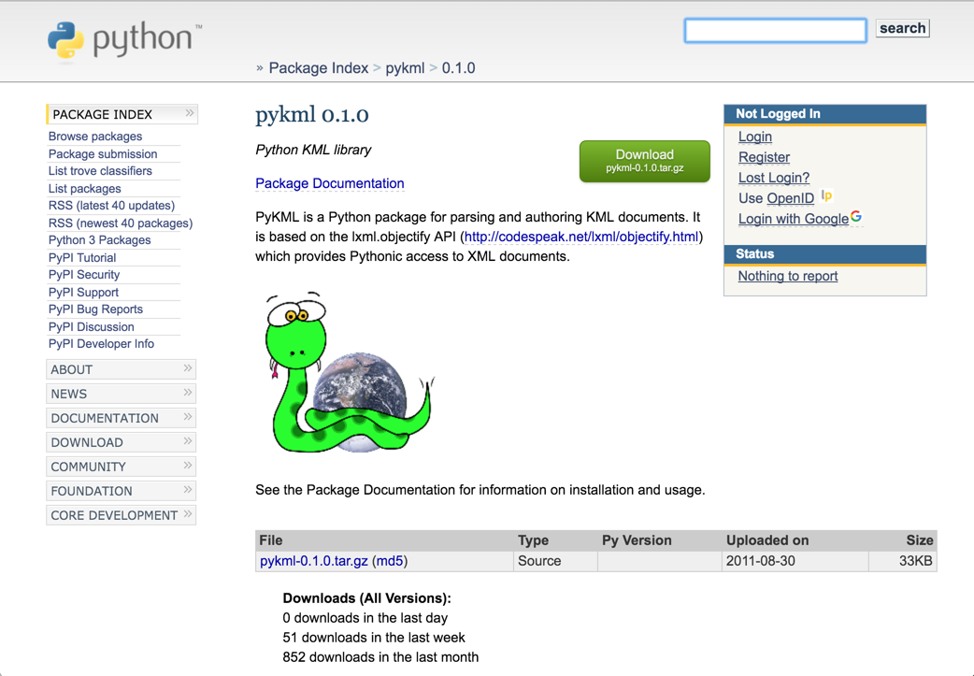

A bit about me...
Notes:
Brief background on Tyler...

Slide 4
API choice: Javascript vs. Python

Slide 5
Objects and Methods are the Same!
Both the Javascript and Python APIs provide access to the same set of Earth Engine objects and methods...
… except… a few methods are capitalized differently
.and() vs. .And()
.or() vs. .Or()
etc.

Slide 6
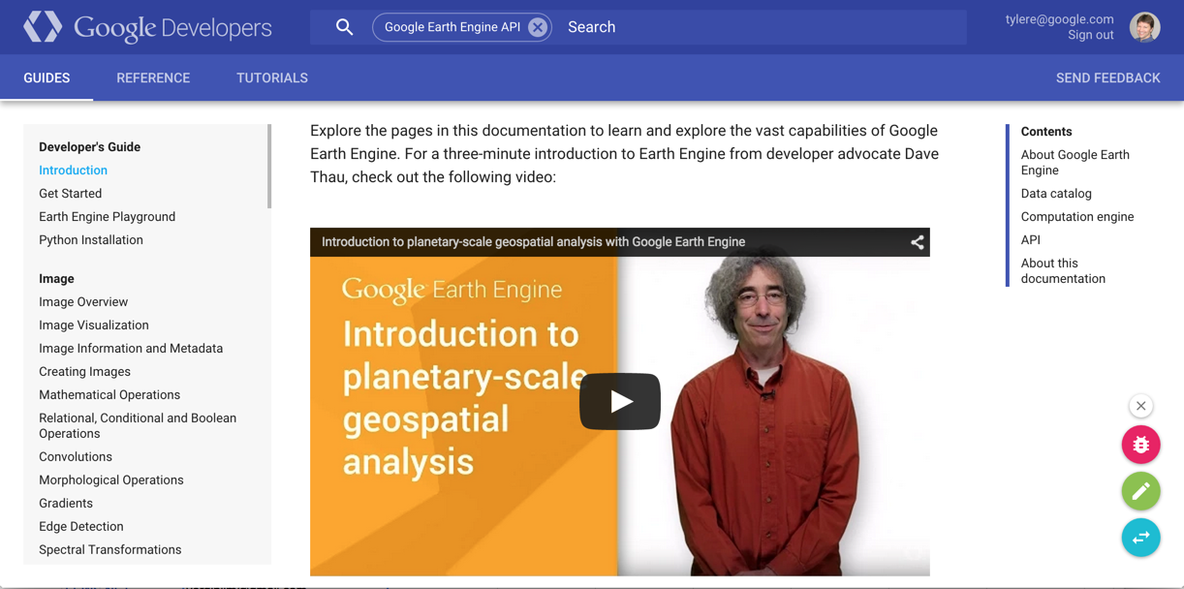
The Docs Apply to Both!

Slide 7
Javascript API vs. Python API
easy to share code between scripts
easy to get started
easier transition to a web application
trivial to share scripts
allows for series of calls to Earth Engine
built in authentication
many, many plotting options
limited input/output functionality
some assembly (& maintenance) required!
can't share code between scripts
Javascript Playground
Python API

Slide 8
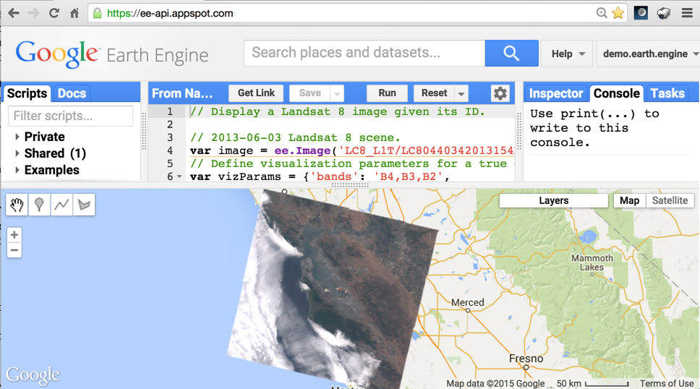

Interaction with the Javascript Playground
Earth Engine

Slide 9
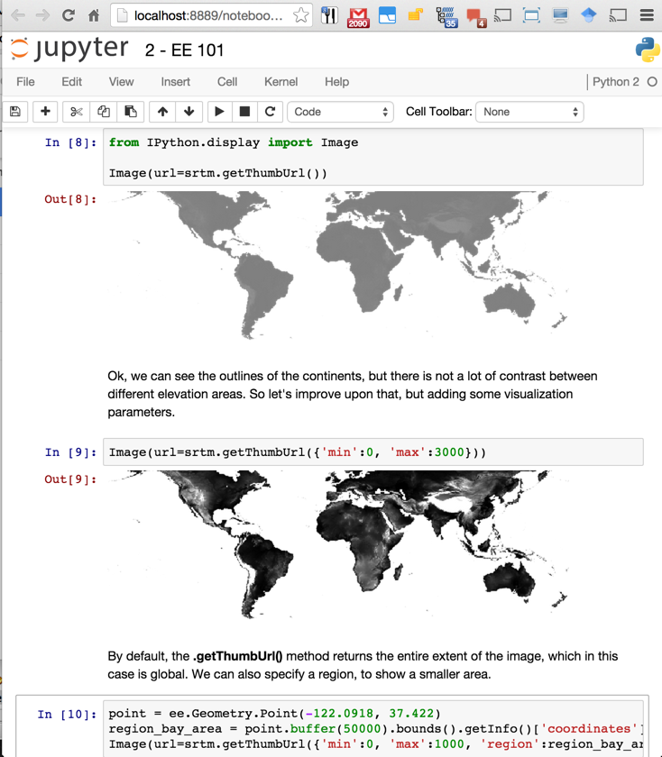
Interaction with Python
Earth Engine
Python Script

Slide 10
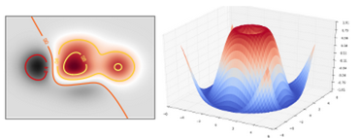
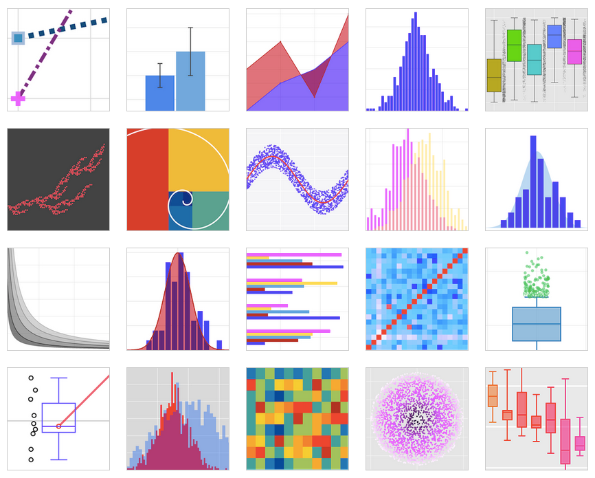
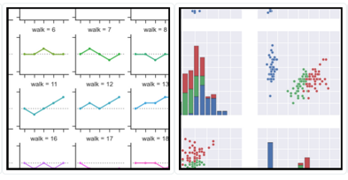
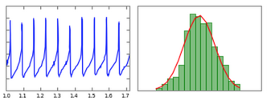
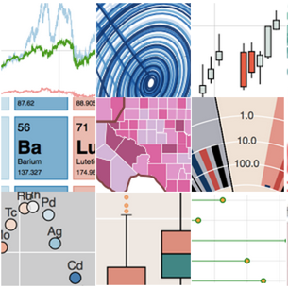
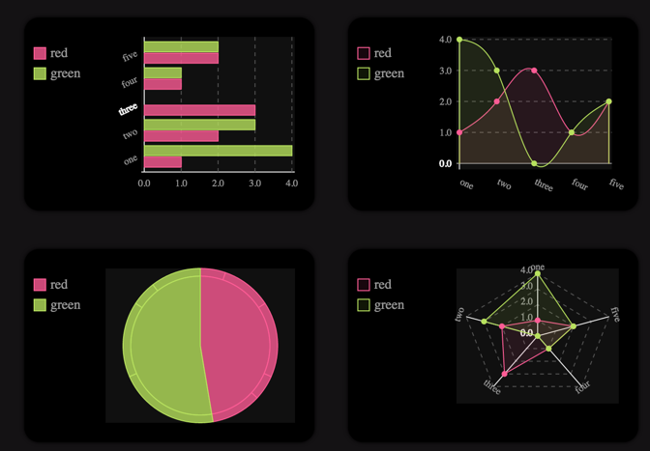
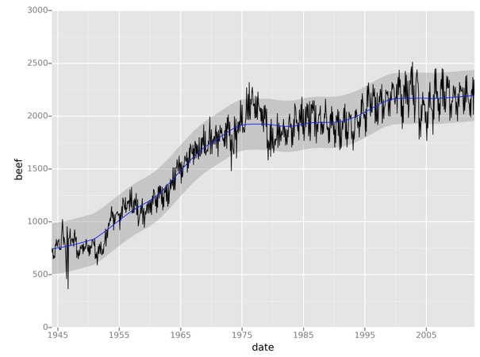

Python Plotting Packages
seaborn
plotly
matplotlib
pygal
ggplot
bokeh

Slide 11
Python Environment Setup
Everyone's Python environment is different!
Many Python libraries depend on non-Python code, that is different on each machine
Multiple Python packaging solutions exist... there is no single community standard
easy_install
pip
wheel
conda

Slide 12

Python Environment Setup
Manual Install
Currently used by EE Docs
Potentially separate install for every OS, Python package version
Conda Install
Packages up Python code and dependencies
Separate packages for Linux, OSX, Windows
Docker Containers
Packages up OS, Python code & dependencies
Single container for Linux (with VM wrapper for OSX & Windows)
Civilization

Slide 13
Clients for the Python API

Slide 14

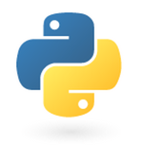
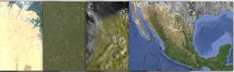

Web-accessible Geospatial API
add
mosaic
Algorithmic Primitives
filter
distance
join
focal_min
convolve
reduce
Python Script
Geospatial Datasets
Storage and Compute
Javascript API Python API

Slide 15

Web-accessible Geospatial API
add
mosaic
Algorithmic Primitives
filter
distance
join
focal_min
convolve
reduce
Jupyter Notebooks
Geospatial Datasets
Storage and Compute
Javascript API Python API

Slide 16
Setting up Your Environment

Slide 17

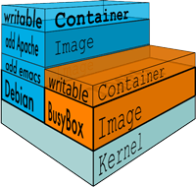
Docker Containers
Containers provide an isolated environment for Python and non-Python code.
Allows for defining a consistent set of libraries needed to run the Earth Engine Python API
Notes:
Source: https://docs.docker.com/

Slide 18
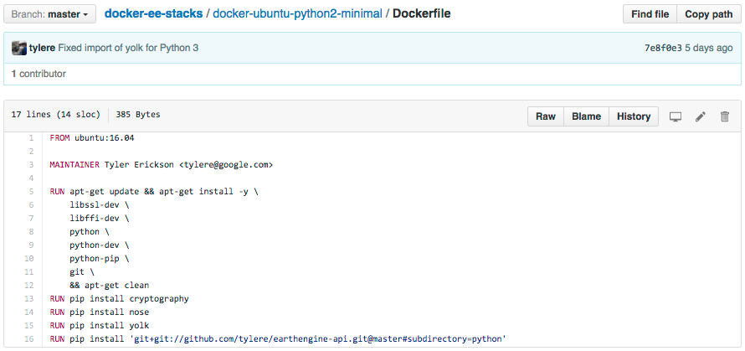
Docker Containers
Container definitions can be hosted on GitHub.
Notes:
Source: https://docs.docker.com/

Slide 19
Containers Registries
Publishing container definitions allows for easy access
Container definitions can be published to:
Docker Hub and/or
Google Container Registry
Notes:
Source: https://docs.docker.com/

Slide 20

Many Deployment Options
Local (OSX, Windows, Linux)
On a Virtual Machine
Google Container Engine
Amazon EC2 Container Service
Microsoft Azure Container Service
IBM Bluemix
Raspberry Pi
etc...
Notes:
Source: https://docs.docker.com/

Slide 21
Docker Container for EE
docker-ee-stacks / docker-ubuntu-python2-minimal
Ubuntu:16.04
Non-Python libraries
libssl-dev
libffi-dev
python
python-dev
python-pip
git
Python libraries
cryptography
nose (optional, for testing)
yolk (optional, for package listing)
Earth Engine Python API
earthengine-api

Slide 22
Docker Container for EE
docker-ee-stacks / docker-debian-python3-scipy-notebook
Base: jupyter/scipy-notebook
Non-Python libraries
libssl-dev
libffi-dev
python3
python3-dev
python3-pip
git
Python libraries
cryptography
nose (optional, for testing)
yolk3k (optional, for package listing)
Earth Engine Python API
earthengine-api
Jupyter Notebooks & SciPy goodness!

Slide 23
Hands on time!
(locally hosted Docker container)

Slide 24
Get Some Earth Engine Results
(OSX) Start up the docker-machine VM docker-machine start eval $(docker-machine env default)
Start up the Docker container docker run -d -P tylere/docker-debian-python3-scipy-notebook
Determine the IP and port for constructing a URL for viewing the notebooks docker-machine ip default docker ps
Notes:
Source: https://docs.docker.com/

Slide 25
Cleaning Up Your Container
List the running containers docker ps
Shut down the docker container docker stop [CONTAINER ID]
Remove the docker container docker rm [CONTAINER ID]
Notes:
Source: https://docs.docker.com/

Slide 26
Hands on time!
(remotely hosted Docker container)

Slide 27

Google Compute Engine Bulk Deployment
Setup:
Create a Virtual Machine (VM) on Google Computer Engine (GCE)
Install Docker
Open up ports for outside access
Start up 100 Docker containers, each on their own port and with their own password
GCE VM
Container 001
Container 002
Container 003
Container 004
Container 100
Docker Engine
Notes:
Source: https://docs.docker.com/

Slide 28
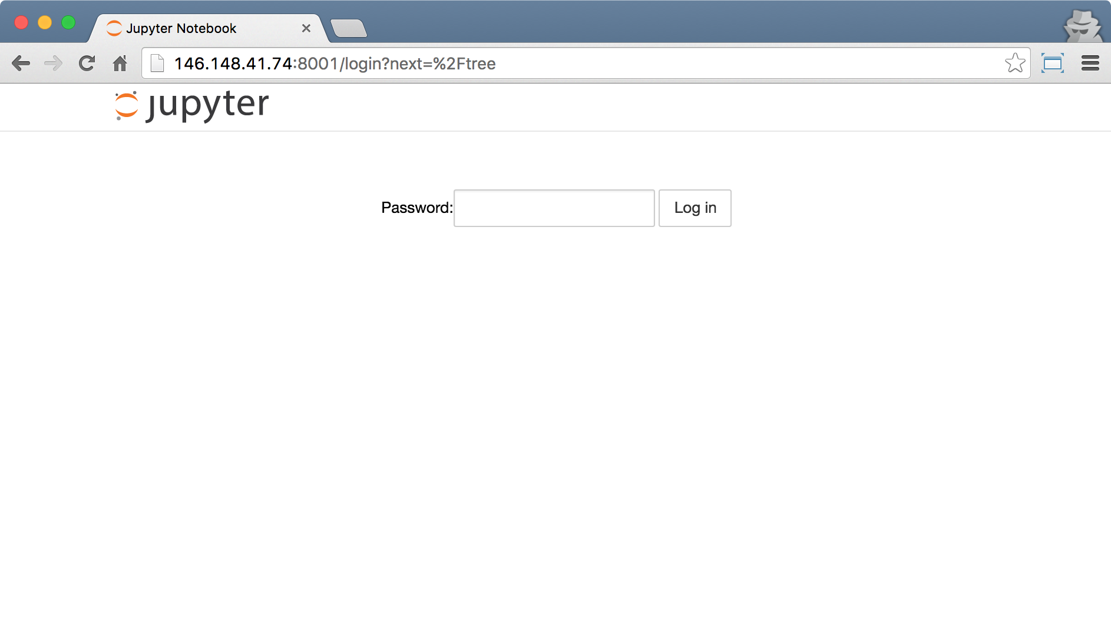
Start your Jupyter Notebooks!
Get your password from your friendly TA!
Notes:
Source: https://docs.docker.com/

Slide 29
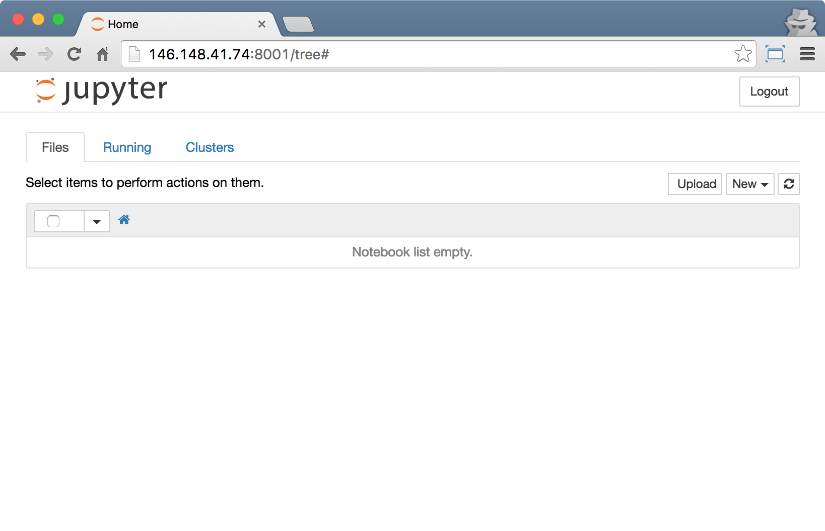
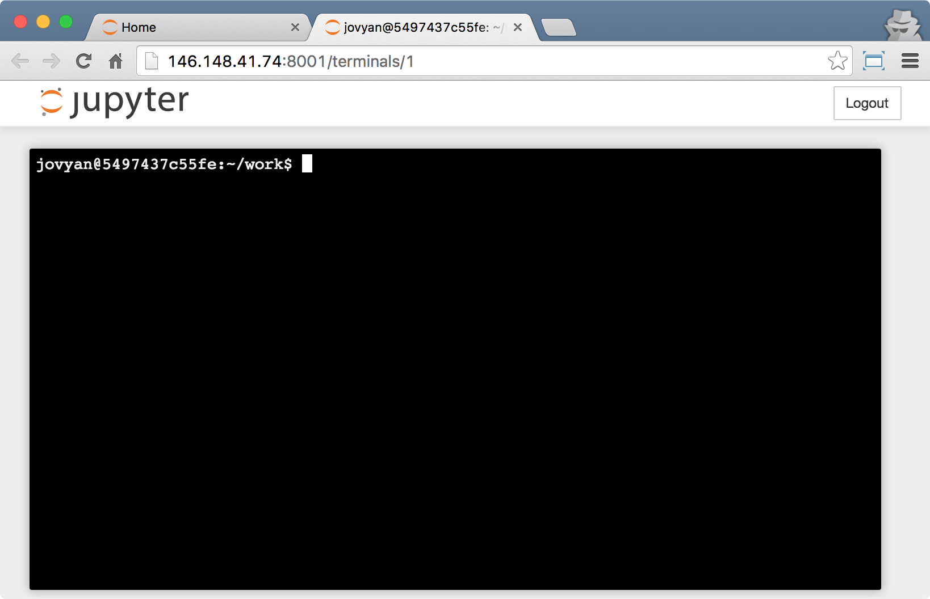
Authenticating to Earth Engine
Login to Jupyter
Select New -> Terminal
Type in: earthengine authenticate
Follow the instructions to complete authentication.
Try it out: python
>>> import ee
>>> ee.Initialize()
Notes:
Source: https://docs.docker.com/

Slide 30
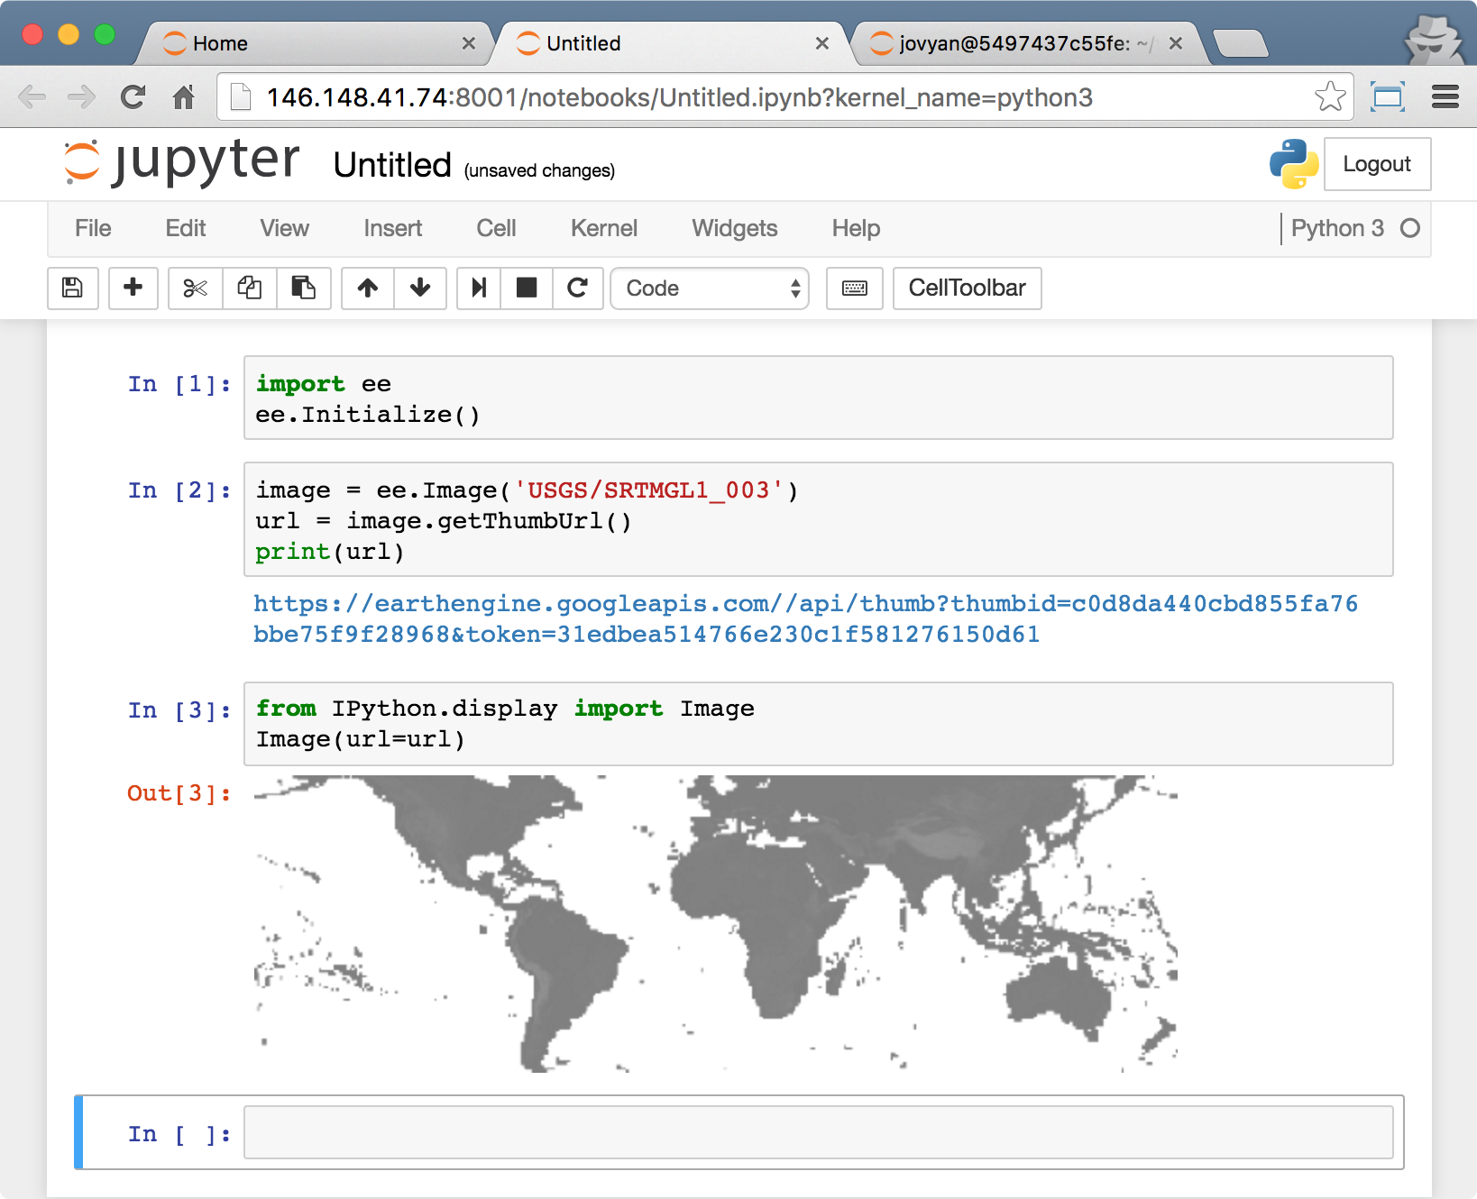
Get Some Earth Engine Results
Return to the Jupyter main window
Select New -> Python 3
Type in:
import ee ee.Initialize()
image = ee.Image('USGS/SRTMGL1_003')
url = image.getThumbUrl()
print(url)
from IPython.display import Image
Image(url=url)
Notes:
Source: https://docs.docker.com/

Slide 31
Get Some Earth Engine Results
Browse a GitHub repo https://github.com/tylere/docker-tmpnb-ee
Get the GitHub URL https://github.com/tylere/docker-tmpnb-ee.git
Open a Jupyter terminal window, and clone the repository git clone https://github.com/tylere/docker-tmpnb-ee.git
Open up interesting notebooks
notebooks / 1 - IPython Notebook Examples / Welcome to Python.ipynb
notebooks / 2 - Earth Engine API Examples / 1 - Earth Engine API Basic Test.ipynb
Notes:
Source: https://docs.docker.com/

Slide 32
Resources
Docker
https://www.docker.com/
https://hub.docker.com/
Google Cloud Platform
https://cloud.google.com/compute/docs/containers/container_vms
Jupyter
http://jupyter.org/
https://nbviewer.jupyter.org/
Earth Engine - Jupyter Experiments
https://github.com/tylere

Slide 33
Listening time!
What do you want for the Python API?

Slide 34
Requests
Jupyter map widget
GetInfo map widget
Access to the documentation
web
Objects and methods
Python 3 compatibility
Helper functions for numpy, pandas, gdal, rasterio, dask
Profiler information

Slide 35
Thank you

